Slide 1
Elements of Music World Tour
Key Stage 2
Week 1 – First stop The British Isles

Slide 2
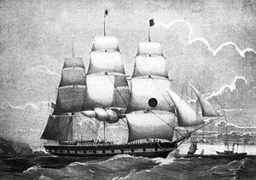
Music of the Week – Sea Shanties Haul Away Joe Performed by The Longest Johns
Listening
Click Here
Questions to think about while you listen
1 This sea shanty has a CALL and RESPONSE structure. Which lyrics do you think are the RESPONSE?
Hint: that’s the bit that has the same words every time!
2 How many singers sing the CALL part of the song?
3 Do you like this music?
4 If yes or no why?

Slide 3
Warm up – A Pirate You Shall Be
Have a go at this pirate themed warm up to get your ears and body ready for music. Feel the steady PULSE as you stamp along in time to the beat.
(Suitable for use in schools not currently singing)
Click Here

Slide 4
Practical Activity – Body Percussion
Learn the Body percussion riff to go with the Song Haul Away Joe
Now try doing it along with the song – practice keeping in time with the music
Click Here
Chest 1 | Chest 2 | Leg leg leg did-dil-ly | Leg dee
Chest 1 | Chest 2 | Leg leg leg did-dil-ly | Leg dee
Haul Away Joe

Slide 5
Creative Activity
Click Here
Can you create your own body percussion beat with your own sounds or rhythm phrase using a grid? Listen to the song while you try out some sounds, then add your idea to the grid (e.g. stomp, clap, click, chest, legs).
Chest 1 | Chest 2 | Leg leg leg did-dil-ly | Leg dee
Haul Away Joe

Slide 6
Reading Music – Rhythm notation
Click Here
Whole note – Semibreve 4 beats
Half note – Minim 2 beats
Quarter note – Crotchet 1 beat
Eight note – Quaver ½ beat

Slide 7
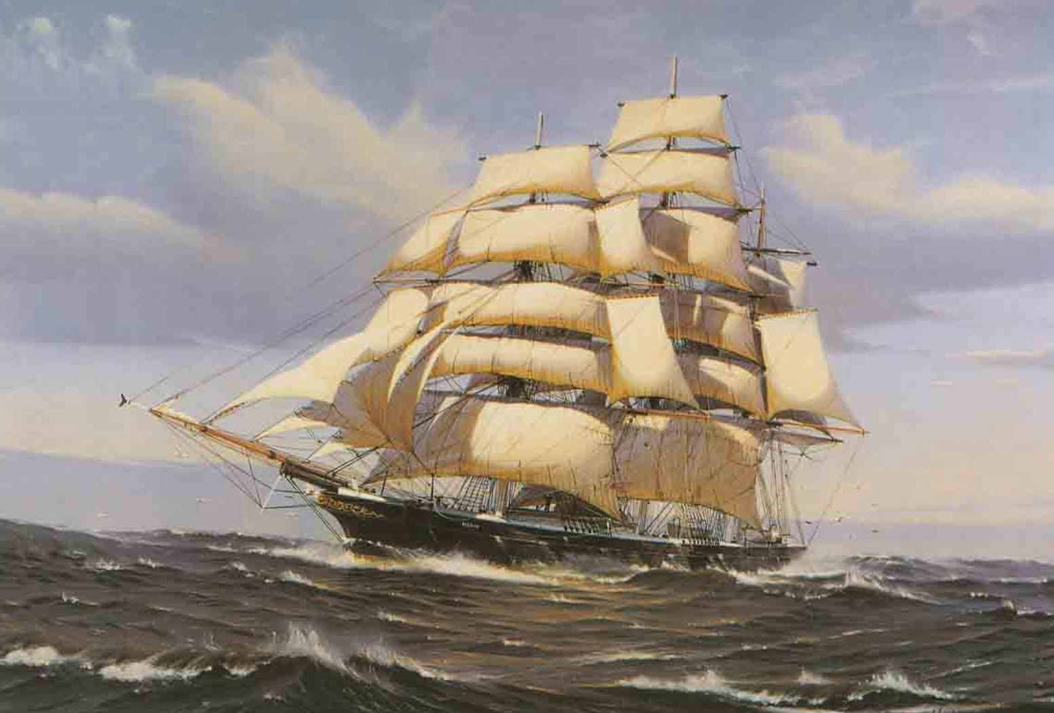
Research Topic
Find out why sailors sang Sea Shanties
1 What were the 3 main types of Shanty?
2 What is the name of the singer who leads the CALL in a shanty?
3 What type of ship is this?
Click Here

