Slide 1
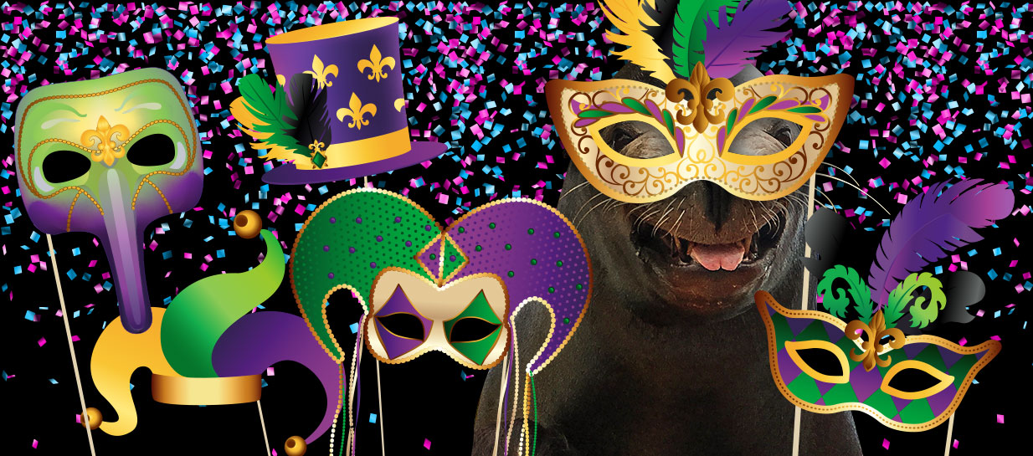
Mardi Gras
New Orleans Style
SOUNDBITES: Digital
World Music Topic
Iko Iko
Week 3

Slide 2
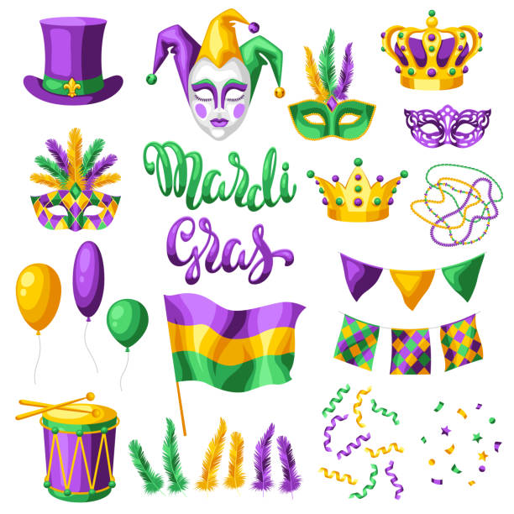
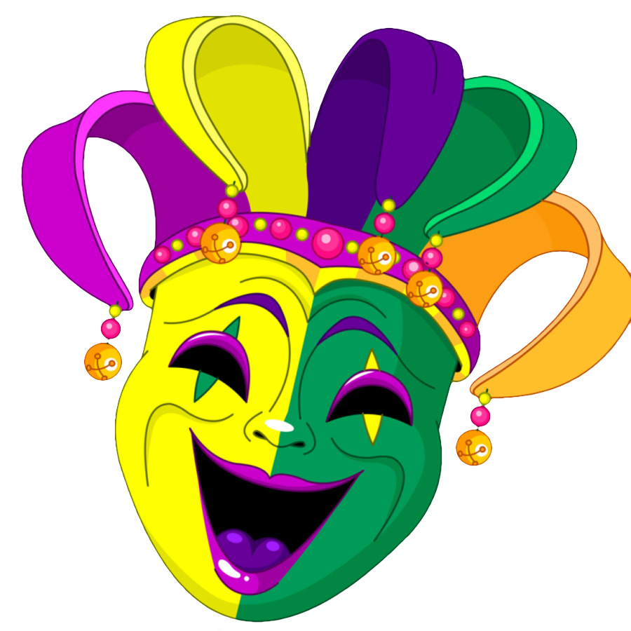
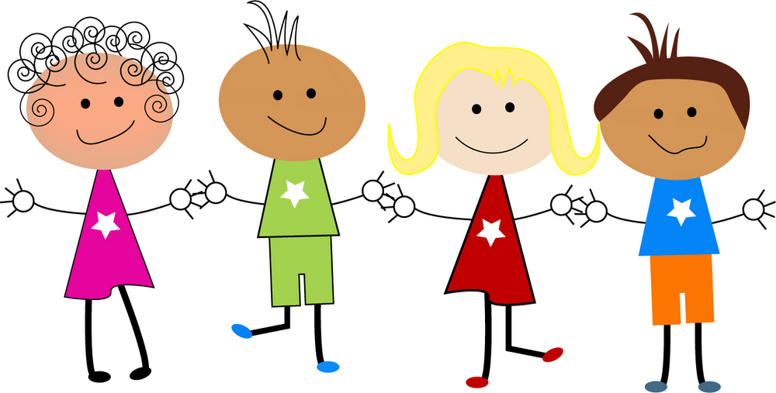
Mardi Gras
Nathaniel: Hey, Tiana! Why are you wearing a jester mask?
Tiana: Because we’re off to New Orleans (USA) for Mardi Gras.
Amanda: And the mascot of Mardi Gras is the Jester, or sometimes called The Joker.
Hashim: What is Mardi Gras?

Slide 3
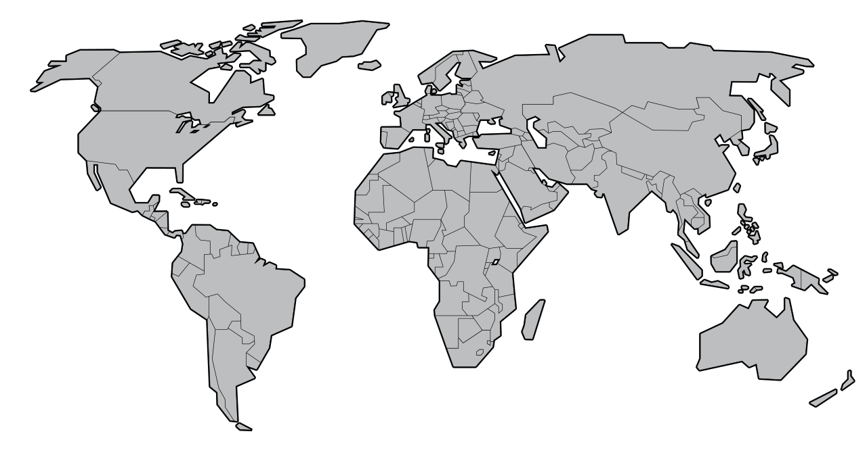
What is Mardi Gras?
It is an annual festival and is traditionally a time for colourful celebrations. Festivities begin at the beginning of February, leading up to Mardi Gras day, and consist of parades, dancing in the street, costumes and masked balls.
Mardi Gras, also known as Fat Tuesday, Shrove Tuesday, Carnival, and even Pancake Day in the UK, takes place each year and will next be celebrated on 16th February 2021. It falls just before Lent and traditionally marks the last time for fun and feasts before 40 days of giving up something you really like to eat, leading up to Easter.
Mardi Gras means "Fat Tuesday" in French.
The modern Carnival tradition developed in Europe in the Middle ages, and is celebrated mainly in Roman Catholic countries in Europe and the Americas today. Some of the most famous celebrations are held in Nice (France), Cologne (Germany), Rio de Janeiro (Brazil) and New Orleans (USA).

Slide 4
Warm-up and Singing : Iko Iko
VERSE
My flag boy and your flag boy
were sit-tin' by the fire
My flag boy told your flag boy
"I'm gon-na set your flag on fire"
CHORUS
VERSE
See that guy all dressed in green
I-ko, I-ko, un-day
He's not a man, he's a lov-in' ma-chine
jock-a mo fee na-né
CHORUS
OUTRO
Talk-in' 'bout, hey now hey now I-ko, I-ko, un-day
Jock-a-mo fee-no ai na-né, jock-a-mo fee na-né
Jock-a-mo fee-no ai na-né, jock-a-mo fee na-né x 4
(Learn to sing with the video clip))
VERSE
My grandma and your grand-ma
were sit-tin' by the fire
My grandma told your grand-ma
"I'm gon-na set your flag on fire
CHORUS
Talk-in' 'bout, hey now hey now I-ko, I-ko, un-day
Jock-a-mo fee-no ai na-né, jock-a-mo fee na-né
VERSE
Look at my king all dressed in red
I-ko, I-ko, un-day
I bet-cha five dol-lars he'll kill you dead,
jock-a-mo fee na-né
CHORUS

Slide 5
Singing Iko Iko: Activities to try…
When you are singing, think about keeping all the lyrics (words) in time with the overall tempo (speed) of the music and singing them clearly with good diction, even the made up ones!
Feeling Unsure? 😐
Try speaking the words in the right rhythm along with the warm up video until you feel confident singing each part correctly or just sing the Verse or Chorus on their own to begin with
Try leaving the phrase “Talk-in’ ‘bout” out of the Chorus so you can take a nice deep breath here and fit in the rest of the words easily
Feeling Confident? 😊
Sing both the Verses and Choruses together all the way through with clear diction and confidence so we can start to understand the story you are telling
Take nice deep breaths where you can; this will help you be able to sing more clearly and fit the words in
Feeling Very Confident? 😃
Try using different dynamics (volume) for different parts of the song in order to tell the listener more of a story or can you try using different types of voices?
Can you add the backing vocal parts in during the chorus and do that with someone else in school or at home?

Slide 6
Marching Rhythms for Iko Iko
Groove rhythms – Play these as repeated patterns
(Learn to play with the video clip)
1
x |  |  |  | x |  |  |  | x |  |  |  | x |  | x
1 |  |  |  | 2 |  |  |  | 3 |  |  |  | Quick- |  | -ly
[rhythm 1 video clip]
2
x |  |  |  | x |  |  |  | x |  |  | x | x |  | x
1 |  |  |  | 2 |  |  |  | I |  |  | like | Ice |  | cream
[rhythm 2 video clip]
3
x |  | x |  | x |  |  |  | x |  | x | x |  | x |  | x
Hey |  | hey |  | hey |  |  |  | I |  | love | dru- |  | -ming |  | and
[rhythm 3 video clip]
4
x |  | x |  | x | x |  |  | x |  |  | x |  |  | x
One |  | too |  | ma- | -ny |  |  | ba- |  |  | -na- |  |  | -nas
[rhythm 4 video clip]

Slide 7
Rhythms for Iko Iko: Activities to try…
You can use any percussion instrument to play these rhythms – even your body!
Feeling Unsure? 😐
Try playing along with the video until you feel confident playing each rhythm clearly
Feeling Confident? 😊
Try playing the rhythms using different sounds – what do they sound like on different instruments or sounds you can play?
If you are in a group, could you play different rhythms at the same time to create layers?
Feeling Very Confident? 😃
Try using different sounds for different parts of the rhythms – could you stomp at the start but clap at the end? What about the other way round? What ideas do you have?
If you are in a group, could you play different rhythms at the same time to create layers?

Slide 8
Let’s put it all together! Play along with [video 3]
VERSE
My grandma and your grand-ma were sit-tin' by the fire
My grandma told your grand-ma "I'm gon-na set your flag on fire
CHORUS
Talk-in' 'bout, hey now hey now I-ko, I-ko, un-day
Jock-a-mo fee-no ai na-né, jock-a-mo fee na-né
VERSE
Look at my king all dressed in red I-ko, I-ko, un-day
I bet-cha five dol-lars he'll kill you dead, jock-a-mo fee na-né
CHORUS
GROOVE Rhythms
x |  |  |  | x |  |  |  | x |  |  |  | x |  | x
1 |  |  |  | 2 |  |  |  | 3 |  |  |  | Quick- |  | -ly
1
x |  |  |  | x |  |  |  | x |  |  | x | x |  | x
1 |  |  |  | 2 |  |  |  | I |  |  | like | Ice |  | cream
2
VERSE
My flag boy and your flag boy were sit-tin' by the fire
My flag boy told your flag boy "I'm gon-na set your flag on fire"
CHORUS
VERSE
See that guy all dressed in green I-ko, I-ko, un-day
He's not a man, he's a lov-in' ma-chine jock-a mo fee na-né
CHORUS
x |  | x |  | x |  |  |  | x |  | x | x |  | x |  | x
Hey |  | hey |  | hey |  |  |  | I |  | love | dru- |  | -ming |  | and
3
x |  | x |  | x | x |  |  | x |  |  | x |  |  | x
One |  | too |  | ma- | -ny |  |  | ba- |  |  | -na- |  |  | -nas
OUTRO
Talk-in' 'bout, hey now hey now I-ko, I-ko, un-day
Jock-a-mo fee-no ai na-né, jock-a-mo fee na-né
Jock-a-mo fee-no ai na-né, jock-a-mo fee na-né x 4
4

